Slide 1

Fuel, Fees, and Fares: What Actually Drives Airline Pricing?
Research Focus
Data E-T-L
Analysis
Key Insights
By: Jackson O’Connell, Sushanth Chunduri CS 2316 Section A | Fall 2025 | Phase III Slide Deck

Slide 2
Research Focus
Data E-T-L
Analysis
Key Insights
Research Focus

Slide 3
Research Question
Research Focus
Data E-T-L
Analysis
Key Insights
Baggage Revenue
Original Questions
Do oil prices meaningfully impact U.S. domestic airfare?
How do baggage-fee revenues relate to airline pricing?
What actually explains airfare changes: costs or demand?
Airfare ($)
CPI / Inflation
Oil Prices

Slide 4
Why This Topic?
Research Focus
Data E-T-L
Analysis
Key Insights
Motivations
Fuel costs are volatile
Baggage revenue keeps rising
Hypothesis: Oil prices should influence fares (and relations w/ baggage revenue)
Personal airline experience and background
Personal interest in commodities markets

Slide 5
Research Focus
Data E-T-L
Analysis
Key Insights
Data E-T-L

Slide 6
Data Sources
Research Focus
Data E-T-L
Analysis
Key Insights
Dataset | Format | Source
BTS Consumer Airfares | CSV | Bureau of Transportation Statistics
BTS Baggage Fees | Excel (XLSX) | Bureau of Transportation Statistics
EIA WTI Oil Prices | JSON | U.S. Enginergy Information Administration
FRED CPI | HTML | Federal Reserve Bank of St. Louis
Source Origins
BTS Consumer Airfares (CSV file)
BTS Baggage Fees (Excel file)
EIA WTI Oil Prices (API request; JSON format)
FRED CPI (HTML scrape w/ BS4)

Slide 7
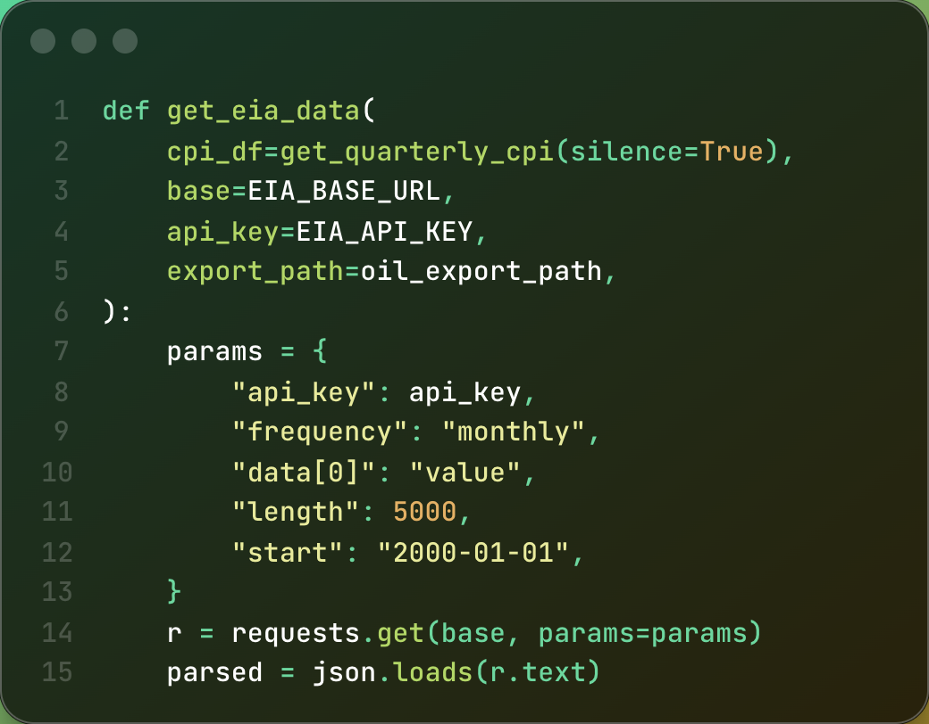
Collection & Integration
Research Focus
Data E-T-L
Analysis
Key Insights
E-T-L Intricacies
Automated scraping & API requests
Monthly -> quarterly conversion
Inflation standardization (2025 dollars)
Various other inconsistencies

Slide 8
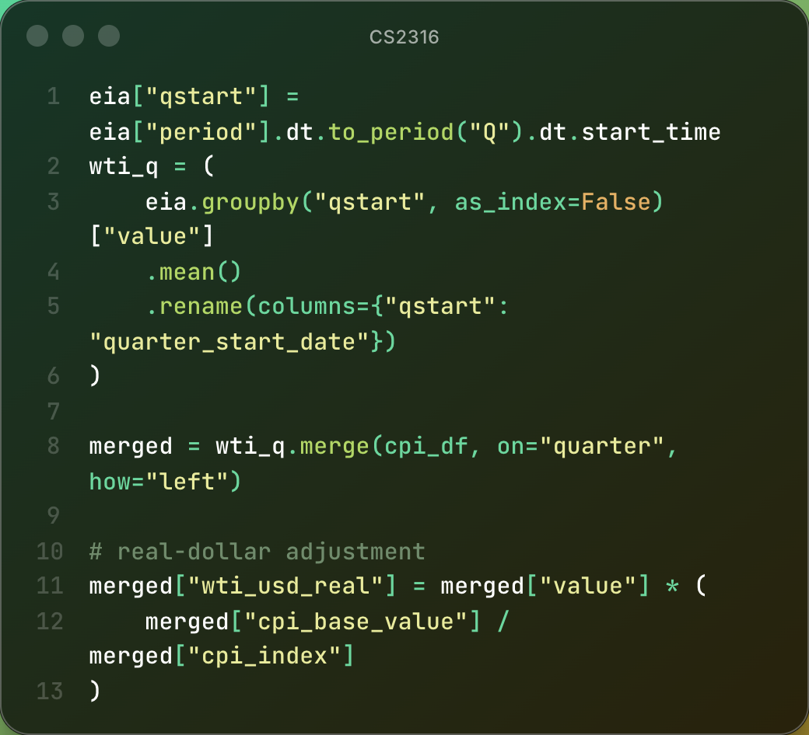
Collection & Integration
Research Focus
Data E-T-L
Analysis
Key Insights
E-T-L Intricacies
Automated scraping & API requests
Monthly -> quarterly conversion
Inflation standardization (2025 dollars)
Various other inconsistencies

Slide 9
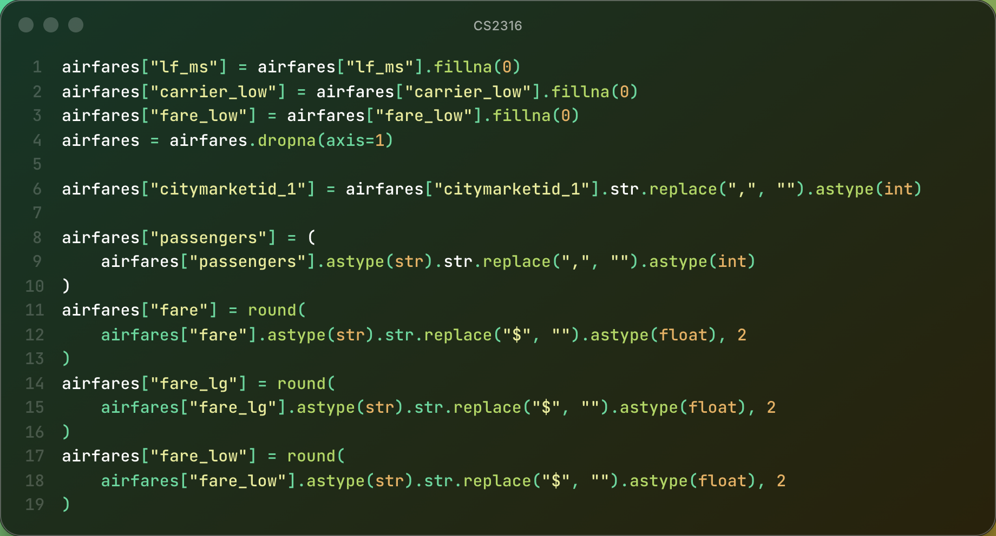
Airfare Dataset Cleaning
Research Focus
Data E-T-L
Analysis
Key Insights
BTS Dataset Intricacies
Fixed commas and dollar signs
Standardized numeric types
Filled missing carrier values
Removed redundant geocode columns

Slide 10
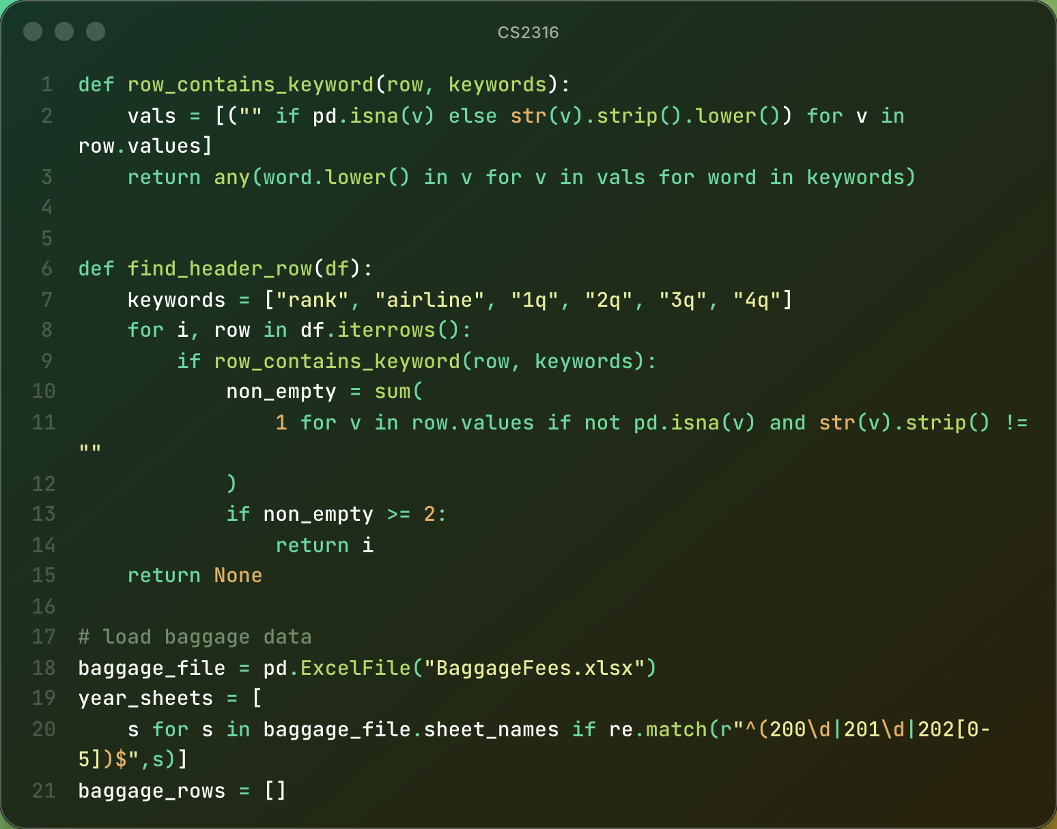
Baggage Dataset Cleaning
Research Focus
Data E-T-L
Analysis
Key Insights
Baggage Dataset Intricacies
Excel/CSV files
19 sheets with inconsistent formats
Custom header-finder
Converted wide → long
Standardized quarterly values

Slide 11
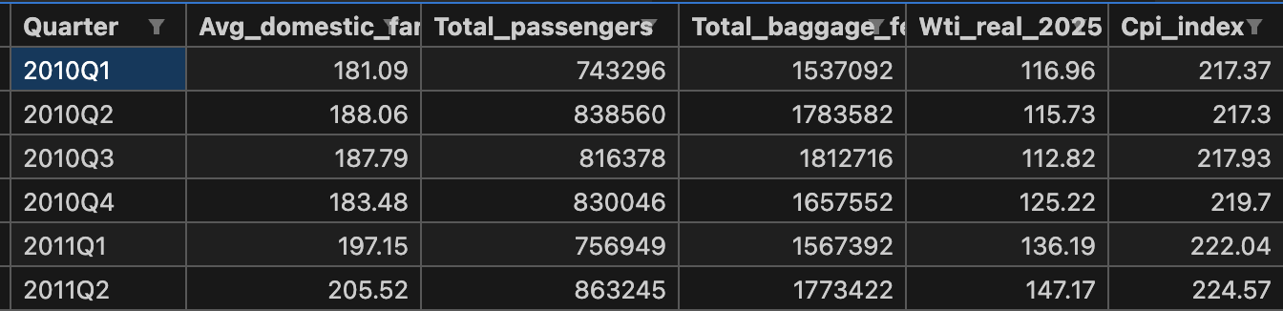
Final Dataset Structure
Research Focus
Data E-T-L
Analysis
Key Insights
Final Dataset Intricacies
2010Q1–2025Q4
Weighted average fares
Real WTI oil prices
Real baggage revenue
Passenger counts

Slide 12
Research Focus
Data E-T-L
Analysis
Key Insights
Analysis

Slide 13
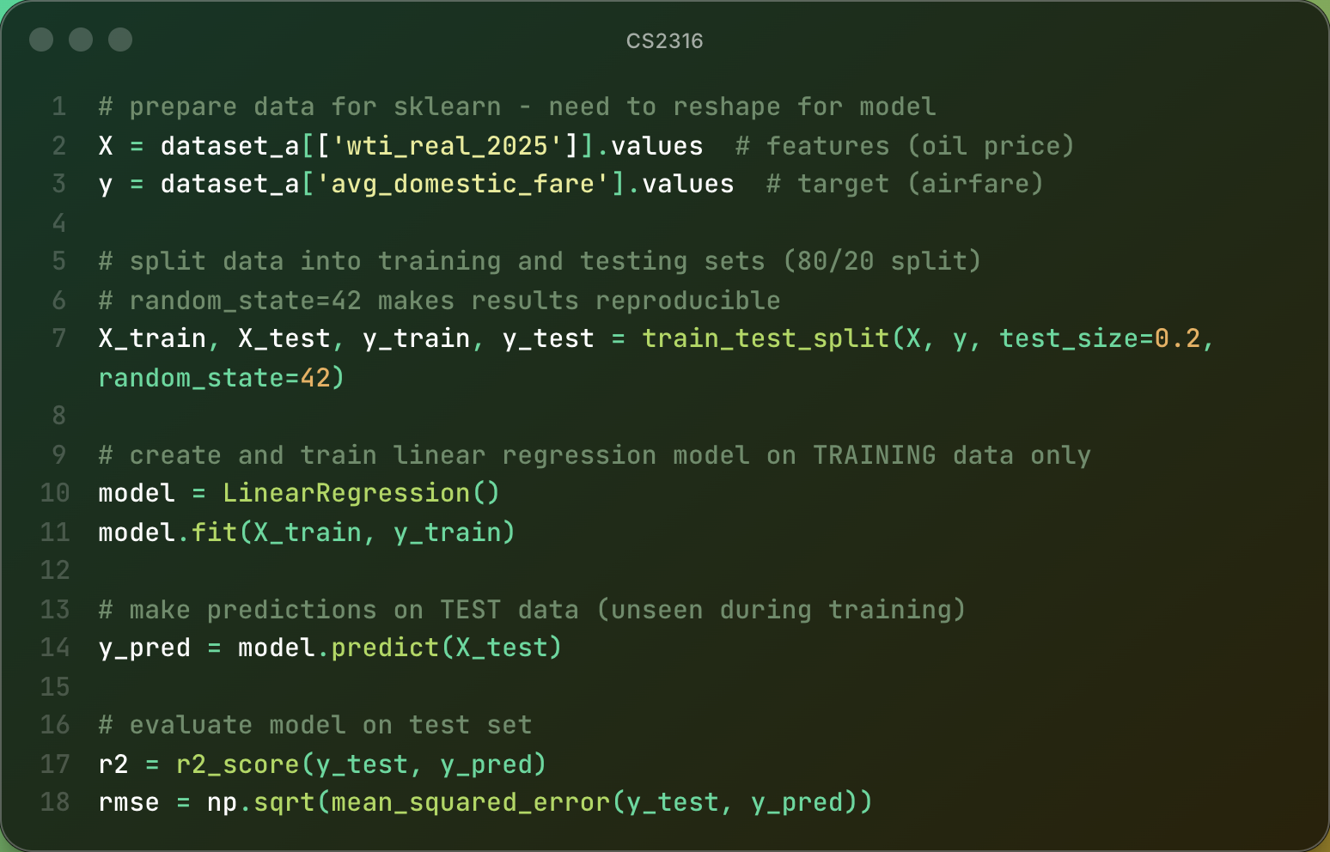
Oil Prices vs Airfares
Research Focus
Data E-T-L
Analysis
Key Insights
Insight #1: Oil -> Fares
Linear regression
R² negative
Slope ≈ near zero
Oil is a bad predictor

Slide 14
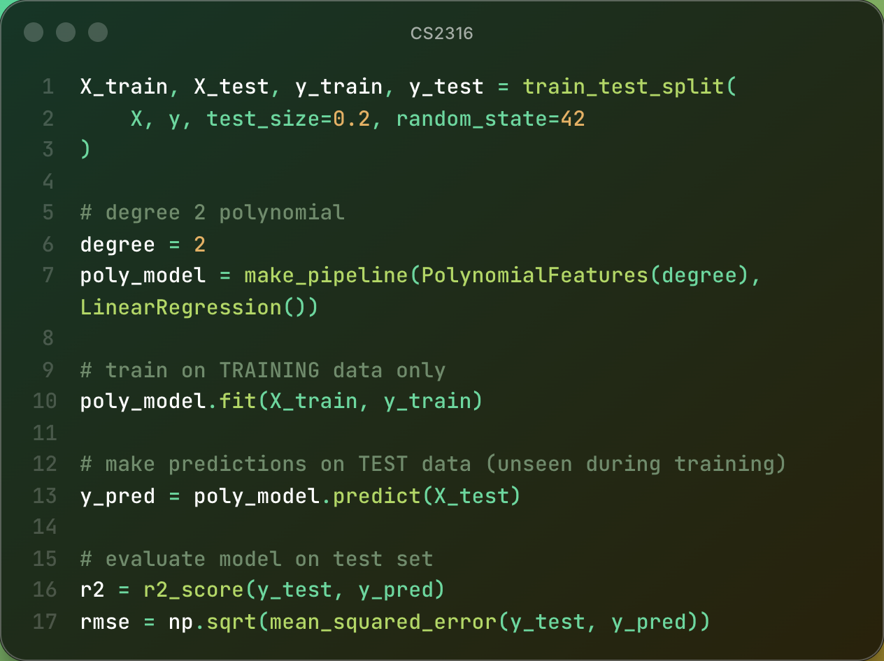
Oil Prices vs Baggage Fees
Research Focus
Data E-T-L
Analysis
Key Insights
Insight #2: Oil -> Baggage Fees
Polynomial Regression
Polynomial degree 2
R² ≈ 0.45
Time trend dominates
Testing at various WTI spot oil prices for realistic analysis

Slide 15
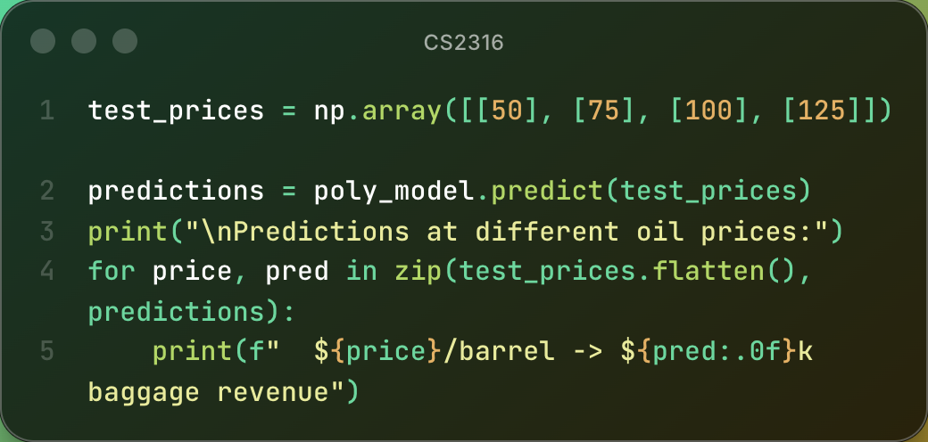
Oil Prices vs Baggage Fees
Research Focus
Data E-T-L
Analysis
Key Insights
Insight #2: Oil -> Baggage Fees
Polynomial Regression
Polynomial degree 2
R² ≈ 0.45
Time trend dominates
Testing at various WTI spot oil prices for realistic analysis

Slide 16
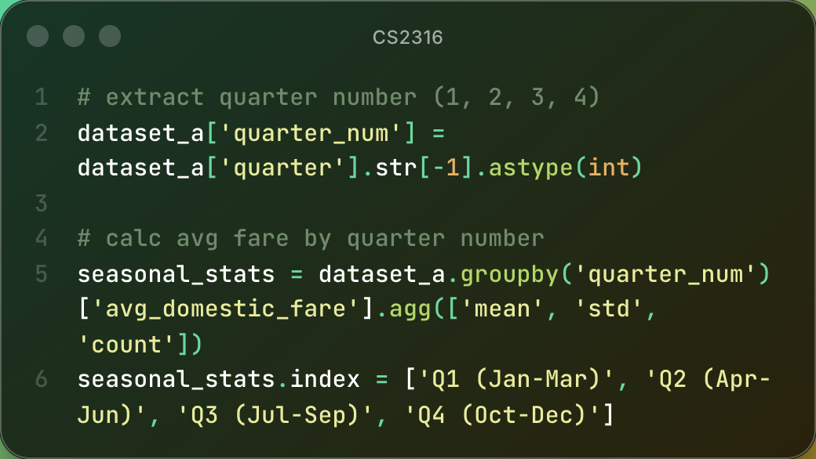
Airfare Across Seasons
Research Focus
Data E-T-L
Analysis
Key Insights
Insight #3: Seasonality Effects
Visual to include:
A small quarterly groupby bar/line chart of average fares by quarter
(Use the existing plot from your notebook: the seasonal groupby(['Quarter']).mean() visualization.)
Quarterly seasonality is low (≈3–4%)
Airfares remain stable across seasons
Demand shifts, not fuel, explain minor seasonal changes

Slide 17
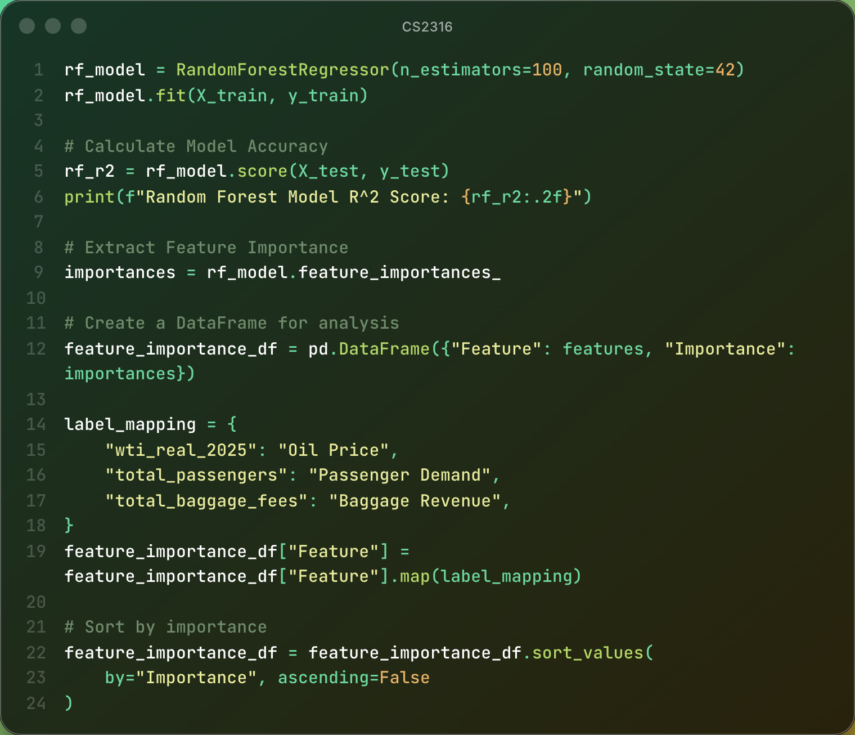
Random Forest Model
Research Focus
Data E-T-L
Analysis
Key Insights
Insight #4: Feature Importance
Visual to include:
Horizontal bar chart of feature importances
(Use the RF importance plot from your notebook: Demand, Baggage Fees, Oil Prices.)
Demand = strongest predictor (≈57%)
Baggage revenue = moderate (≈34%)
Oil prices = weakest predictor (≈8%)
Pricing is multi-factor, not cost-driven

Slide 18
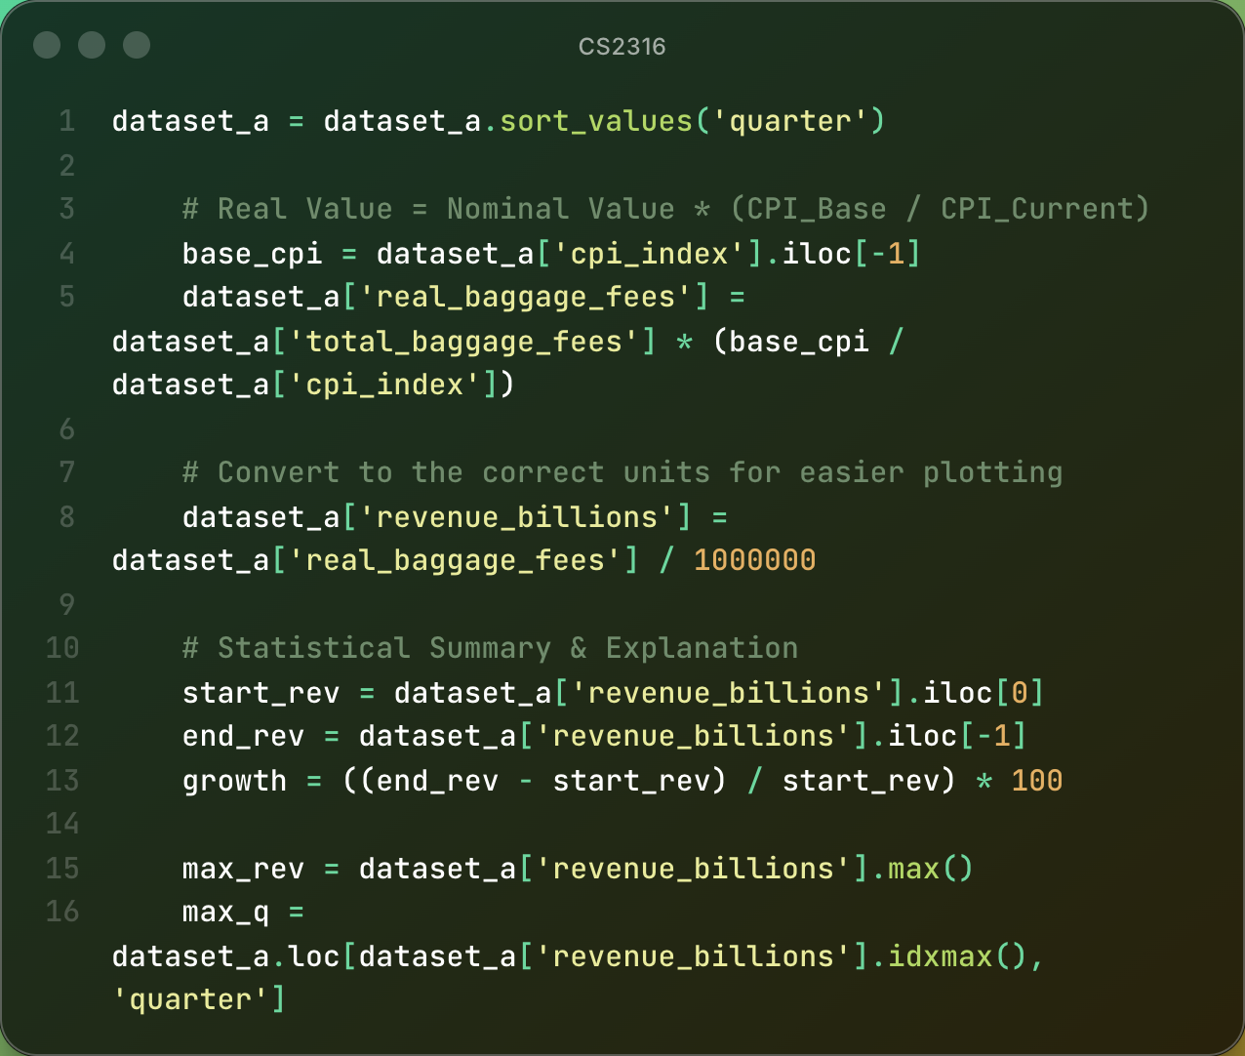
Baggage Revenue Trends
Research Focus
Data E-T-L
Analysis
Key Insights
Insight #5: Seasonality Effects
+133% real increase
COVID dip → strong rebound
Structural reliance on fees
Visual / Code Snip:
Real baggage revenue calculation snippet.

Slide 19
Research Focus
Data E-T-L
Analysis
Key Insights
Key Insights

Slide 20
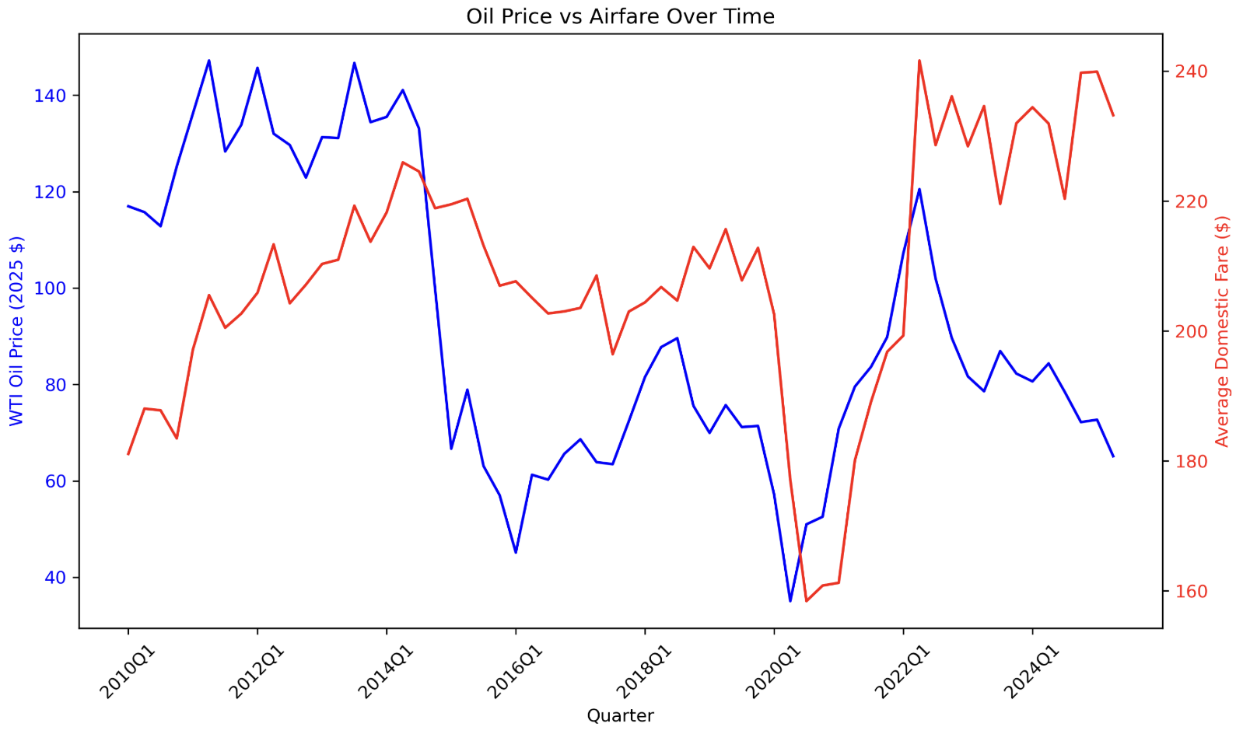
Data Visual #1: Oil vs Airfare
Research Focus
Data E-T-L
Analysis
Key Insights

Slide 21
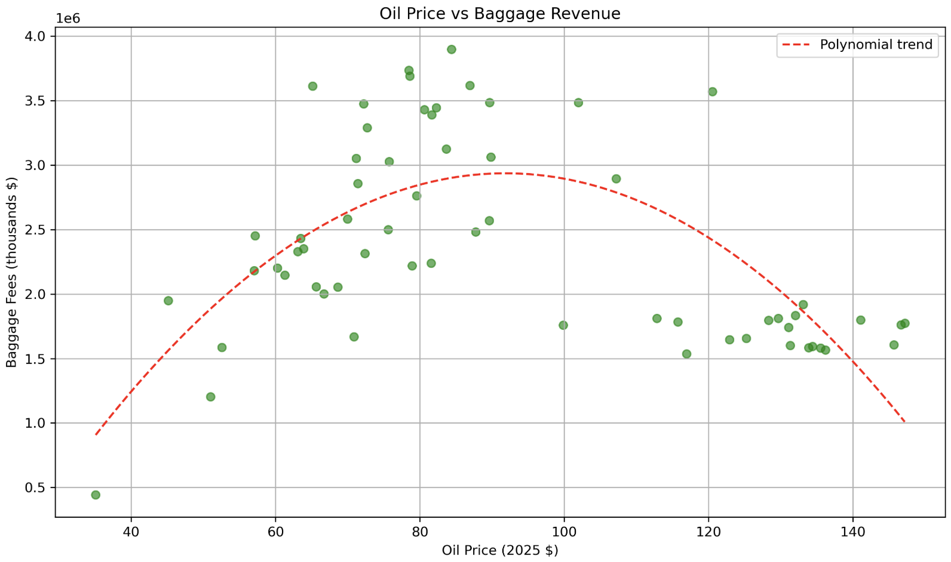
Data Visual #2: Oil vs Baggage Fees
Research Focus
Data E-T-L
Analysis
Key Insights

Slide 22
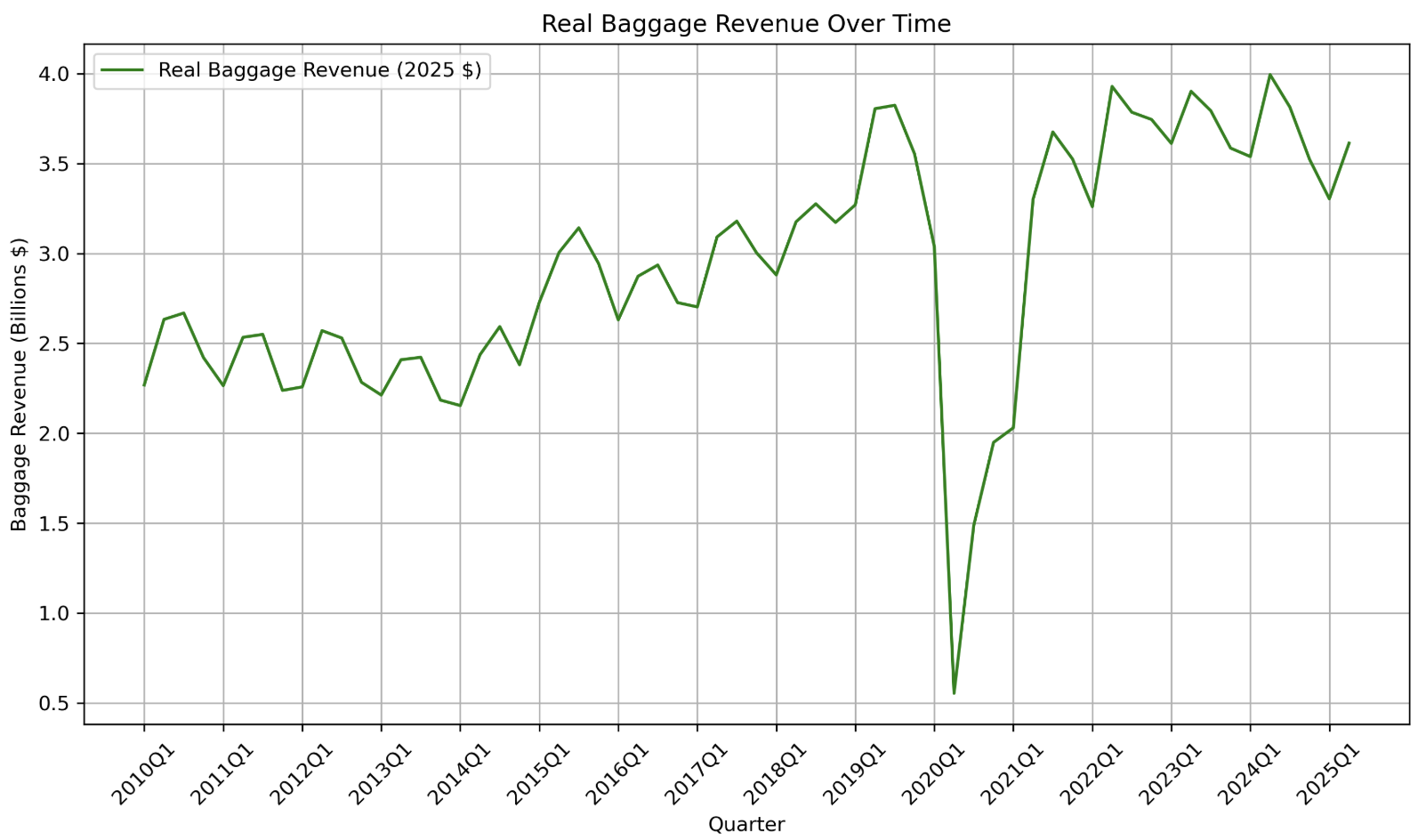
Data Visual #3: Real Baggage Revenue
Research Focus
Data E-T-L
Analysis
Key Insights

Slide 23
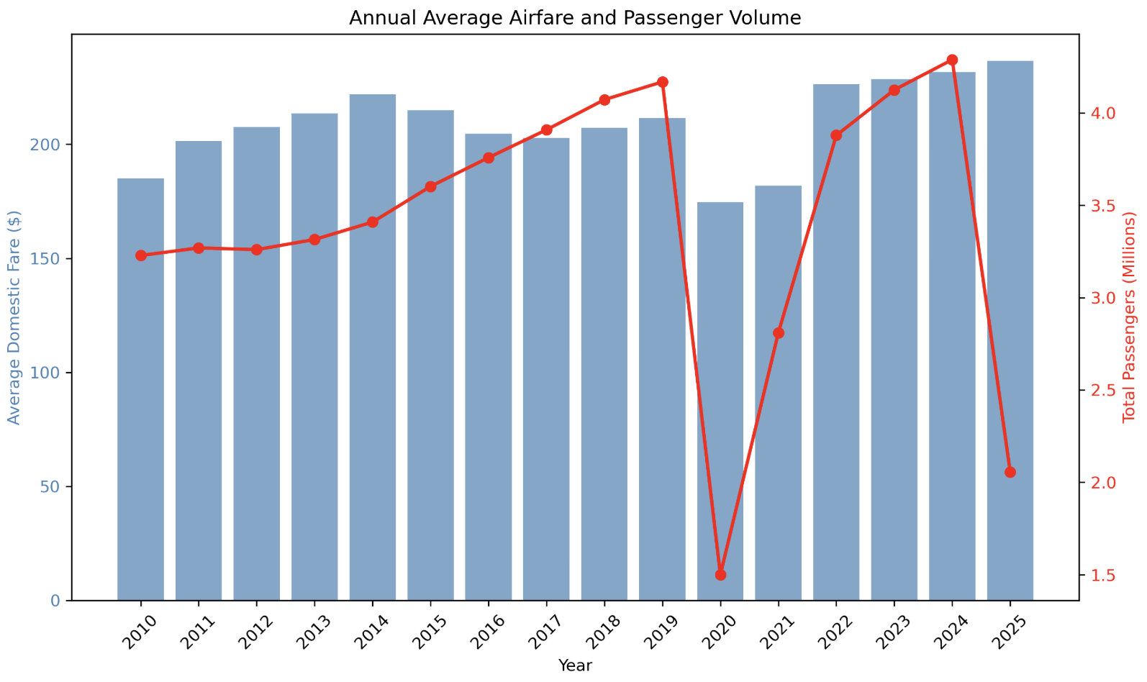
Data Visual #4: YoY Volume and Airfare
Research Focus
Data E-T-L
Analysis
Key Insights

Slide 24
Key Takeaways
Research Focus
Data E-T-L
Analysis
Key Insights
Key Takeaways
Oil prices do not drive airfare changes
Passenger demand is the primary pricing influence
Baggage fees provide stable, structural revenue growth
Airfare behavior reflects multi-factor, non-linear dynamics

Slide 25
Challenges & Learned Skills
Research Focus
Data E-T-L
Analysis
Key Insights
Lessons Learned
Parsing complex, inconsistent Excel sheets
Building robust API and web-scraping workflows
Performing inflation adjustments and real-dollar conversions
Developing regression and machine-learning models
Merging, validating, and maintaining multi-source datasets

Slide 26

Research Focus
Data E-T-L
Analysis
Key Insights
Thank You!

